Slide 1
CSCI2100E Hashing

Slide 2
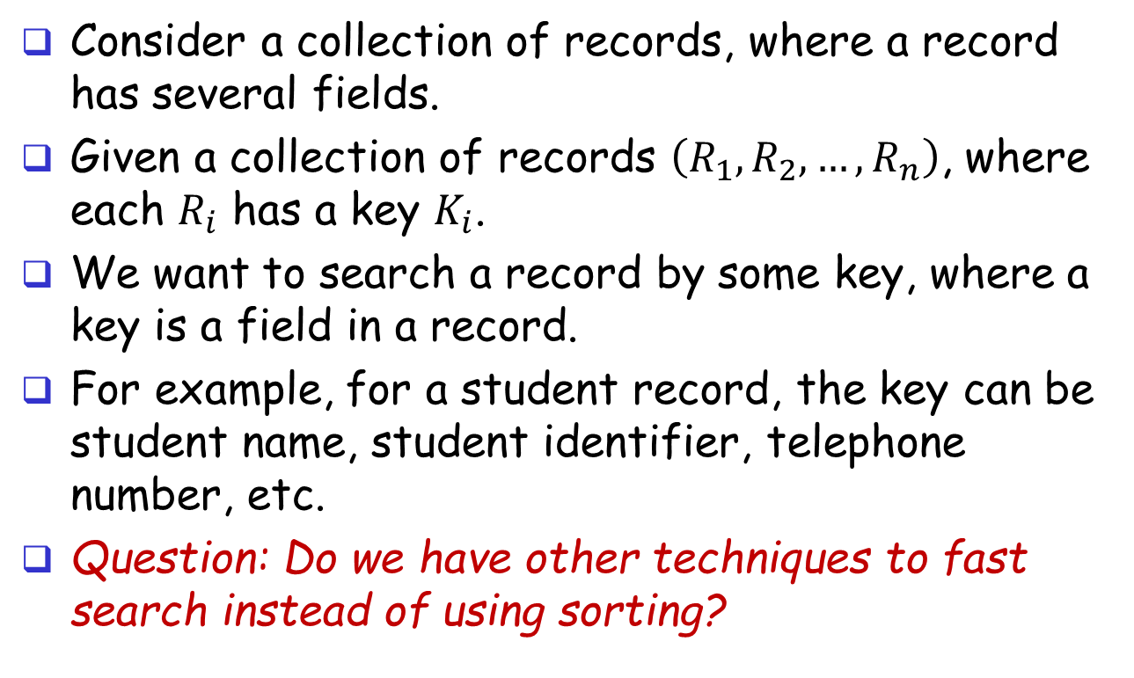
Search Records
Consider a collection of records, where a record has several fields.
Given a collection of records $\left(R_{1},R_{2},…,R_{n}\right)$, where each $R_{i}$ has a key $K_{i}$.
We want to search a record by some key, where a key is a field in a record.
For example, for a student record, the key can be student name, student identifier, telephone number, etc.
Question: Do we have other techniques to fast search instead of using sorting?

Slide 3

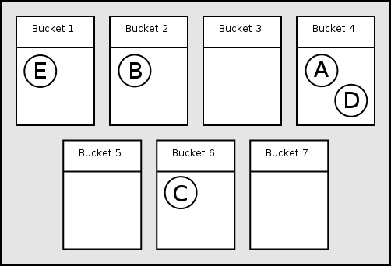
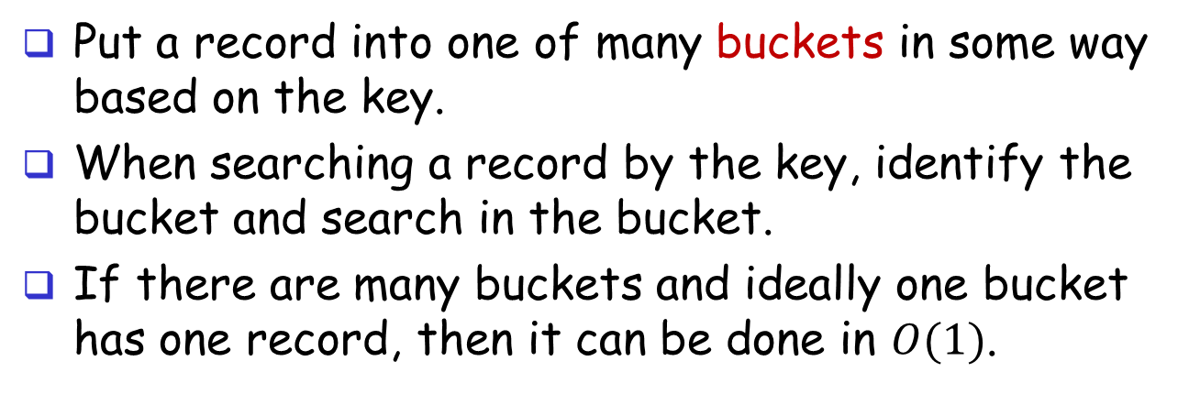
Hashing: Main Ideas
Put a record into one of many buckets in some way based on the key.
When searching a record by the key, identify the bucket and search in the bucket.
If there are many buckets and ideally one bucket has one record, then it can be done in $O(1)$.

Slide 4
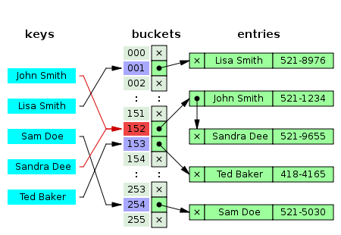
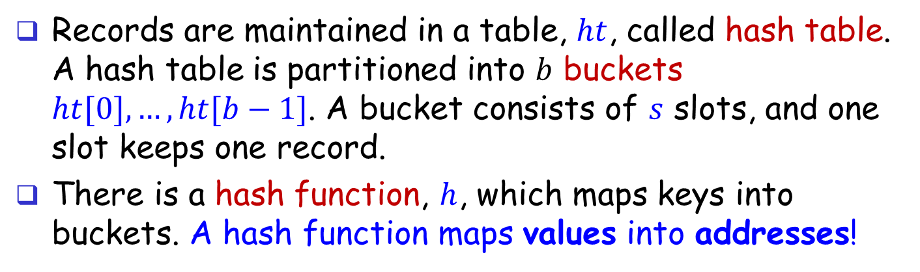
Hashing: Main Ideas
Records are maintained in a table, $ht$, called hash table. A hash table is partitioned into $b$ buckets $ht[0], …, ht[b−1]$. A bucket consists of $s$ slots, and one slot keeps one record.
There is a hash function, $h$, which maps keys into buckets. A hash function maps values into addresses!
hash function

Slide 5
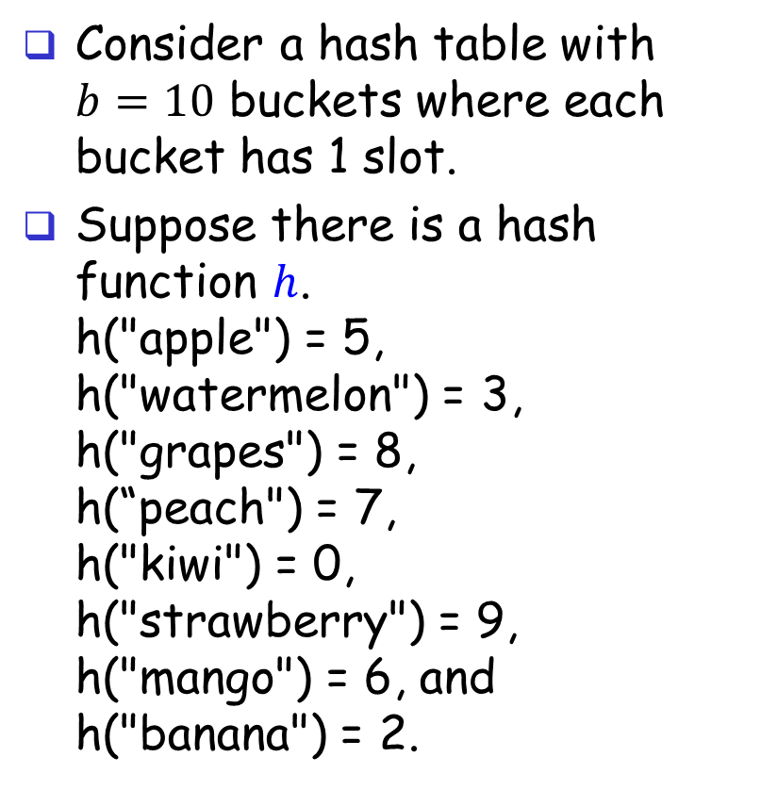
An Ideal Case
Consider a hash table with $b=10$ buckets where each bucket has 1 slot.
Suppose there is a hash function $h$. h("apple") = 5, h("watermelon") = 3, h("grapes") = 8, h(“peach") = 7, h("kiwi") = 0, h("strawberry") = 9, h("mango") = 6, and h("banana") = 2.
0
1
2
3
4
5
6
7
8
9
kiwi
banana
watermelon
apple
mango
peach
grapes
strawberry

Slide 6
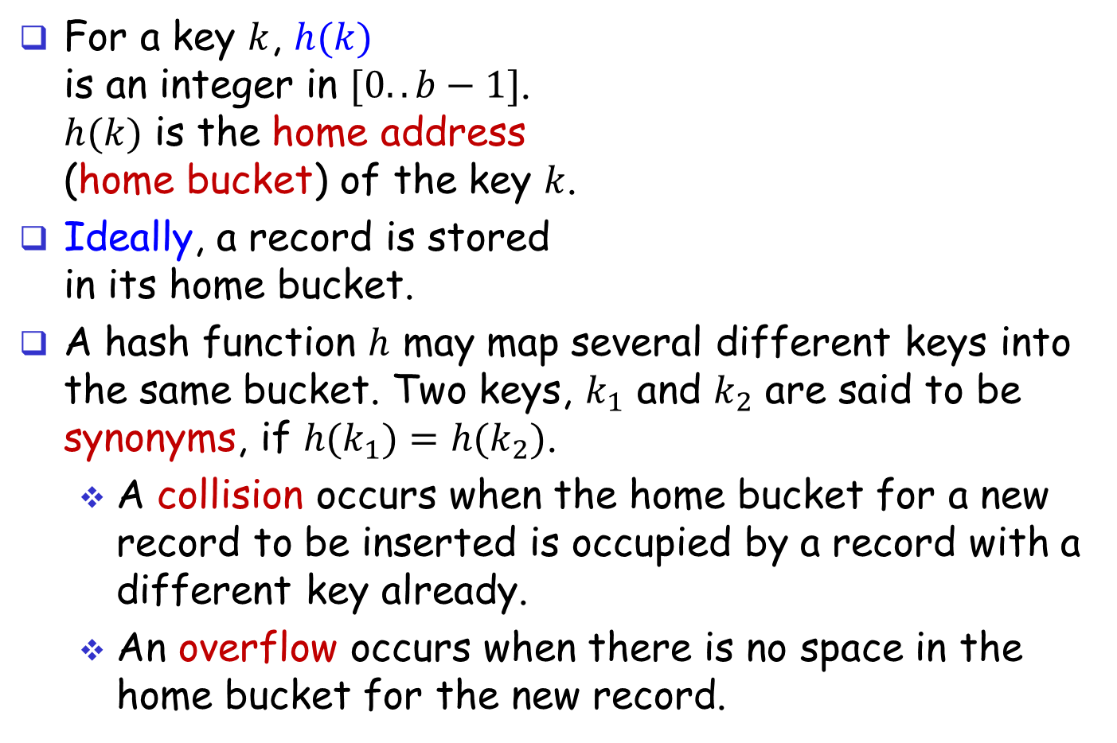
To Be Realistic
For a key $k$, $h(k)$ is an integer in $[0..b−1]$. $h(k)$ is the home address (home bucket) of the key $k$.
Ideally, a record is stored in its home bucket.
A hash function $h$ may map several different keys into the same bucket. Two keys, $k_{1}$ and $k_{2}$ are said to be synonyms, if $h(k_{1})=h(k_{2})$.
A collision occurs when the home bucket for a new record to be inserted is occupied by a record with a different key already.
An overflow occurs when there is no space in the home bucket for the new record.
hash function

Slide 7
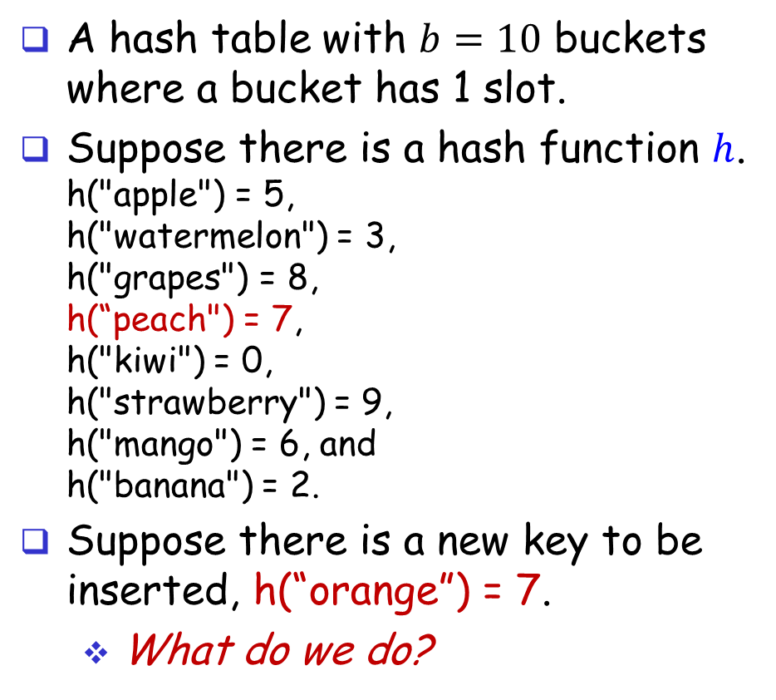
Reconsider the Ideal Case
A hash table with $b=10$ buckets where a bucket has 1 slot.
Suppose there is a hash function $h$. h("apple") = 5, h("watermelon") = 3, h("grapes") = 8, h(“peach") = 7, h("kiwi") = 0, h("strawberry") = 9, h("mango") = 6, and h("banana") = 2.
Suppose there is a new key to be inserted, h(“orange”) = 7.
What do we do?
0
1
2
3
4
5
6
7
8
9
kiwi
banana
watermelon
apple
mango
peach
grapes
strawberry

Slide 8
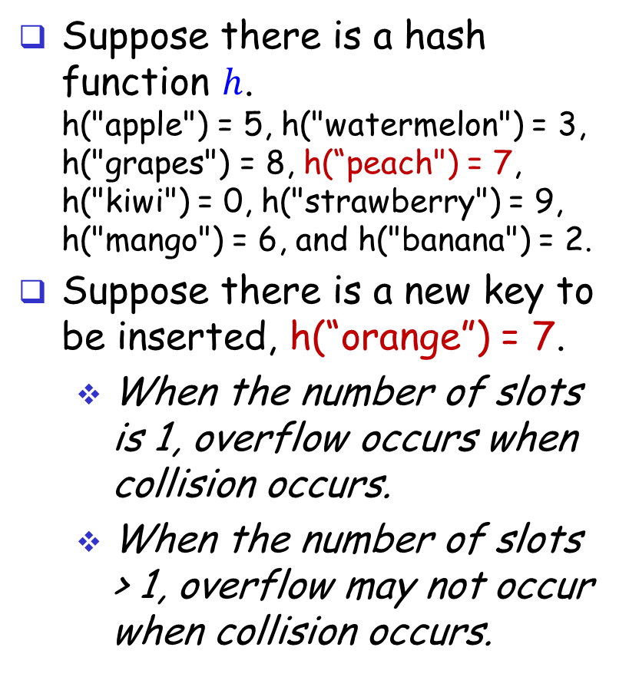
Collision and Overflow
Suppose there is a hash function $h$. h("apple") = 5, h("watermelon") = 3, h("grapes") = 8, h(“peach") = 7, h("kiwi") = 0, h("strawberry") = 9, h("mango") = 6, and h("banana") = 2.
Suppose there is a new key to be inserted, h(“orange”) = 7.
When the number of slots is 1, overflow occurs when collision occurs.
When the number of slots > 1, overflow may not occur when collision occurs.
Slot-1
Slot-2
0
1
2
3
4
5
6
7
8
9
kiwi
banana
watermelon
apple
mango
peach
grapes
strawberry

Slide 9
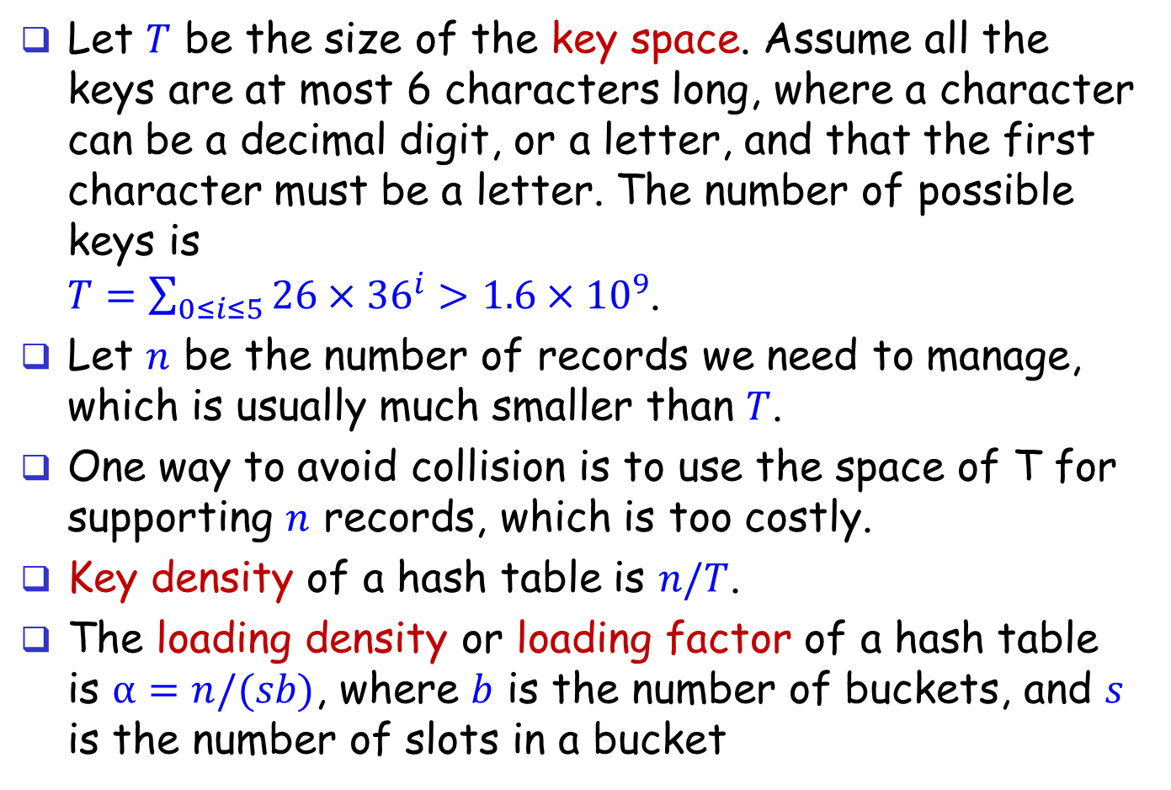
Hard to Avoid Collisions
Let $T$ be the size of the key space. Assume all the keys are at most 6 characters long, where a character can be a decimal digit, or a letter, and that the first character must be a letter. The number of possible keys is $T=\sum_{0≤i≤5}{26×{36}^{i}>1.6×{10}^{9}}$.
Let $n$ be the number of records we need to manage, which is usually much smaller than $T$.
One way to avoid collision is to use the space of T for supporting $n$ records, which is too costly.
Key density of a hash table is $n/T$.
The loading density or loading factor of a hash table is $α=n/(sb)$, where $b$ is the number of buckets, and $s$ is the number of slots in a bucket

Slide 10
Collision Handling
Design a good hash function that can be computed fast and can minimize the number of collisions.
Design a mechanism to handle overflows, since overflows will occur.

Slide 11
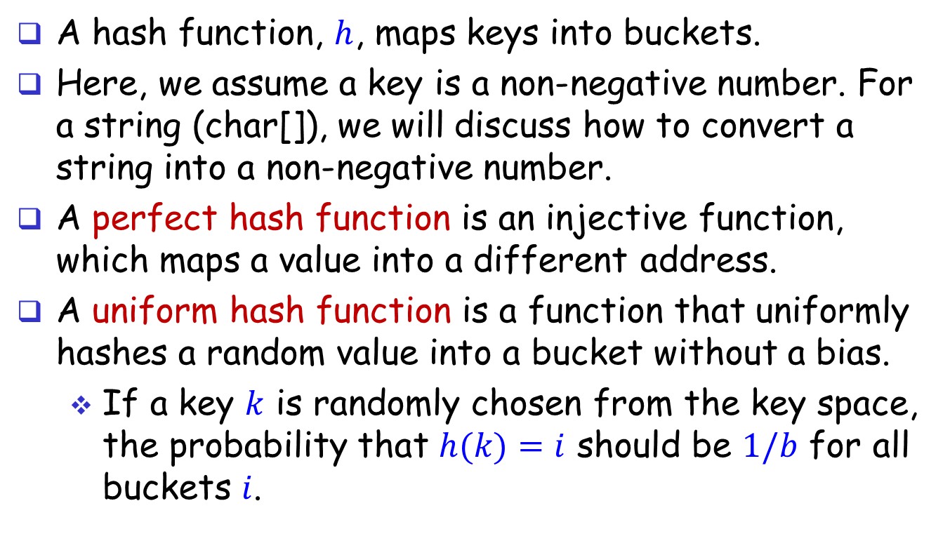
Hash Functions
A hash function, $h$, maps keys into buckets.
Here, we assume a key is a non-negative number. For a string (char[]), we will discuss how to convert a string into a non-negative number.
A perfect hash function is an injective function, which maps a value into a different address.
A uniform hash function is a function that uniformly hashes a random value into a bucket without a bias.
If a key $k$ is randomly chosen from the key space, the probability that $h(k)=i$ should be $1/b$ for all buckets $i$.

Slide 12
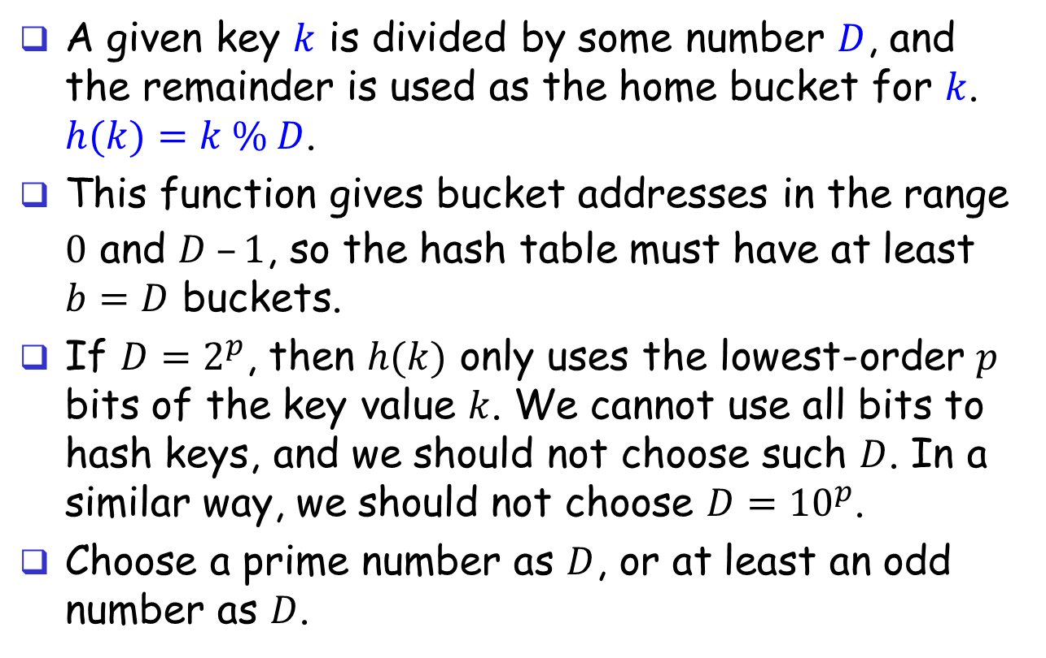
Hash Function: Division
A given key $k$ is divided by some number $D$, and the remainder is used as the home bucket for $k$. $h(k)=k \% D$.
This function gives bucket addresses in the range $0$ and $D –1$, so the hash table must have at least $b=D$ buckets.
If $D=2^{p}$, then $h(k)$ only uses the lowest-order $p$ bits of the key value $k$. We cannot use all bits to hash keys, and we should not choose such $D$. In a similar way, we should not choose $D={10}^{p}$.
Choose a prime number as $D$, or at least an odd number as $D$.

Slide 13
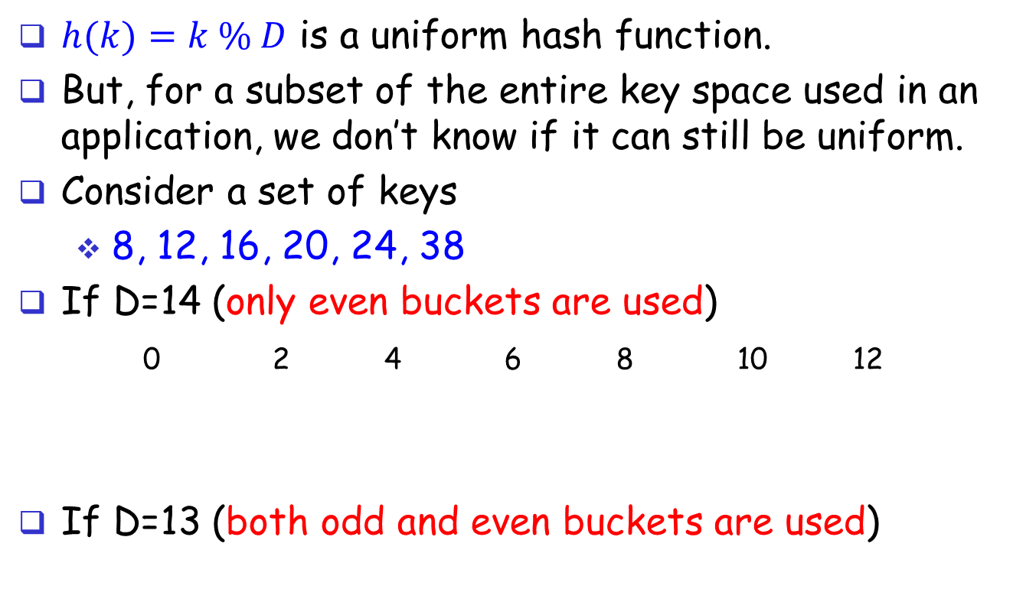
Hash Function: Division
$h(k)=k \% D$ is a uniform hash function.
But, for a subset of the entire key space used in an application, we don’t know if it can still be uniform.
Consider a set of keys
8, 12, 16, 20, 24, 38
If D=14 (only even buckets are used)
0 2 4 6 8 10 12
If D=13 (both odd and even buckets are used)
 |  | 16 |  |  |  | 20 |  | 8 |  | 24 38 |  | 12
 |  | 38 | 16 |  |  |  | 20 | 8 |  |  | 24 | 12

Slide 14
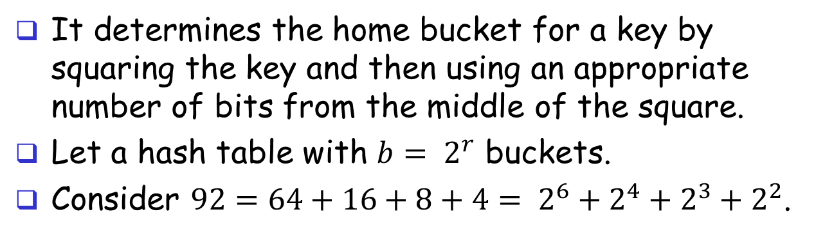
Hash Function: Mid-Square
It determines the home bucket for a key by squaring the key and then using an appropriate number of bits from the middle of the square.
Let a hash table with ${b= 2}^{r}$ buckets.
Consider $92={64+16+8+4= 2}^{6}+2^{4}+2^{3}+2^{2}$.
0
0
0
0
0
1
0
1
1
1
0
0
92
0
1
0
0
0
0
1
0
0
0
1
0
0
0
0
92x92=8464
r bits

Slide 15
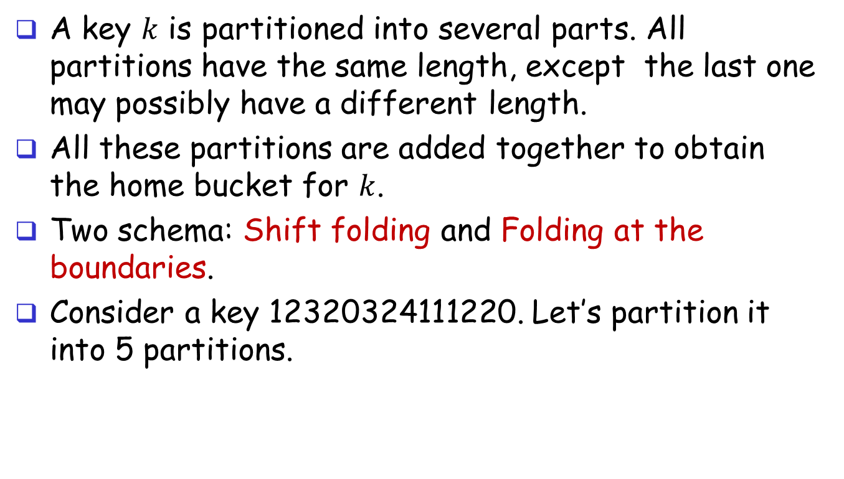
Hash Function: Folding
A key $k$ is partitioned into several parts. All partitions have the same length, except the last one may possibly have a different length.
All these partitions are added together to obtain the home bucket for $k$.
Two schema: Shift folding and Folding at the boundaries.
Consider a key 12320324111220. Let’s partition it into 5 partitions.
P1
P2
P3
P4
P5
1
2
3
2
0
3
2
4
1
1
1
2
2
0

Slide 16
Hash Function: Folding
P1
1 2 3
P1
1 2 3
P2
2 0 3
P2
3 0 2
P3
2 4 1
P3
2 4 1
P4
1 1 2
P4
2 1 1
P5
2 0
P5
2 0
6 9 9
8 9 7
Shift folding
Folding at the boundaries

Slide 17
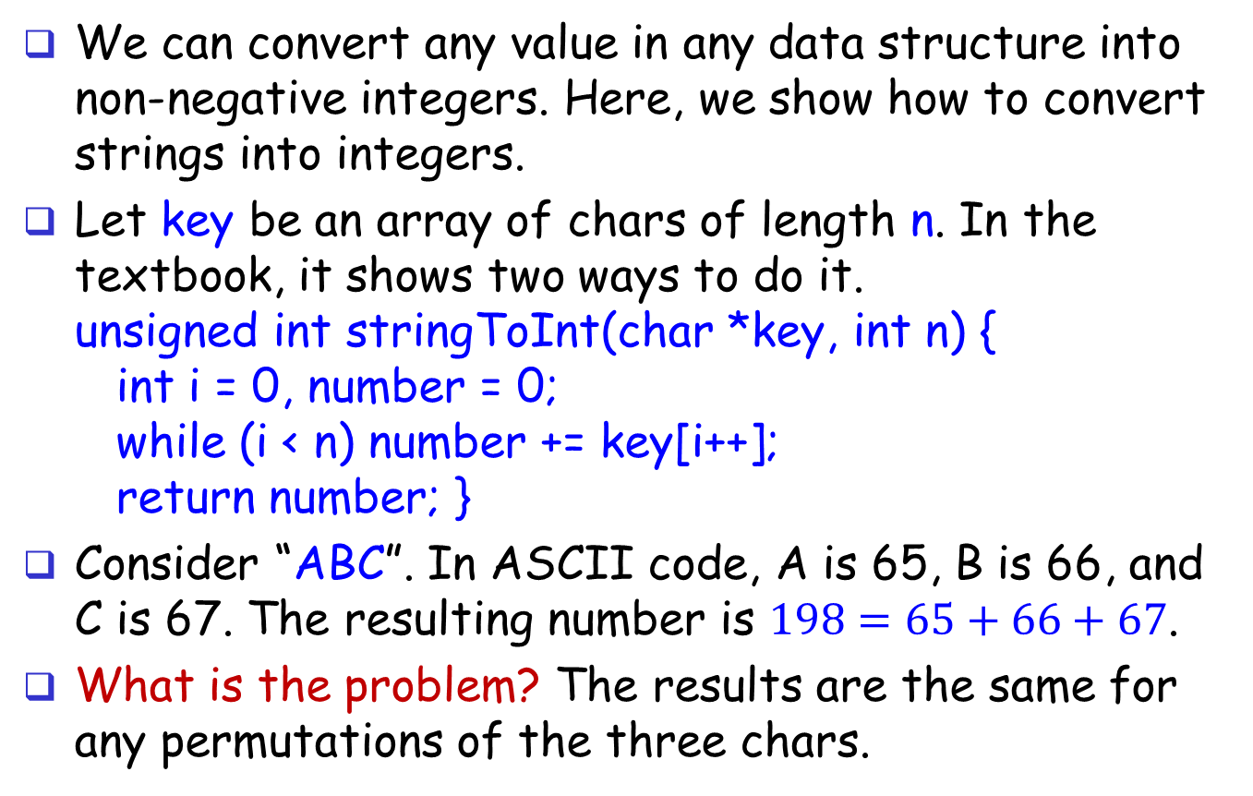
Convert Strings to Integers
We can convert any value in any data structure into non-negative integers. Here, we show how to convert strings into integers.
Let key be an array of chars of length n. In the textbook, it shows two ways to do it. unsigned int stringToInt(char *key, int n) { int i = 0, number = 0; while (i < n) number += key[i++]; return number; }
Consider “ABC”. In ASCII code, A is 65, B is 66, and C is 67. The resulting number is $198=65+66+67$.
What is the problem? The results are the same for any permutations of the three chars.

Slide 18
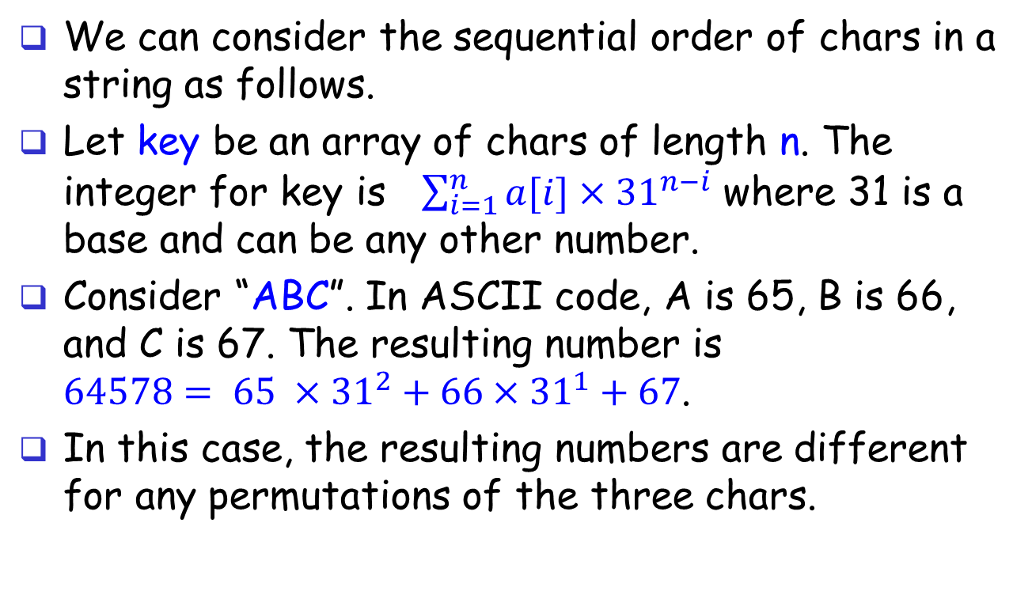
Convert Strings to Integers
We can consider the sequential order of chars in a string as follows.
Let key be an array of chars of length n. The integer for key is $\sum_{i=1}^{n}{a[i]×{31}^{n−i}}$ where 31 is a base and can be any other number.
Consider “ABC”. In ASCII code, A is 65, B is 66, and C is 67. The resulting number is $64578= 65 ×{31}^{2}+{66×31}^{1}+67$.
In this case, the resulting numbers are different for any permutations of the three chars.

Slide 19
Overflow Handling
When an overflow occurs, we cannot insert a record into its home bucket, because by overflow it means that the home bucket is full.
We have to handle overflow by finding a new place to insert a new record.
Two methods: Open Addressing & Chaining (Assume s = 1)
Open Addressing: Search a bucket that is not full yet in the hash table in a systematic manner.
Linear probing (known as linear open addressing)
Quadratic probing
Rehashing
Chaining: each bucket uses a linked list.

Slide 20
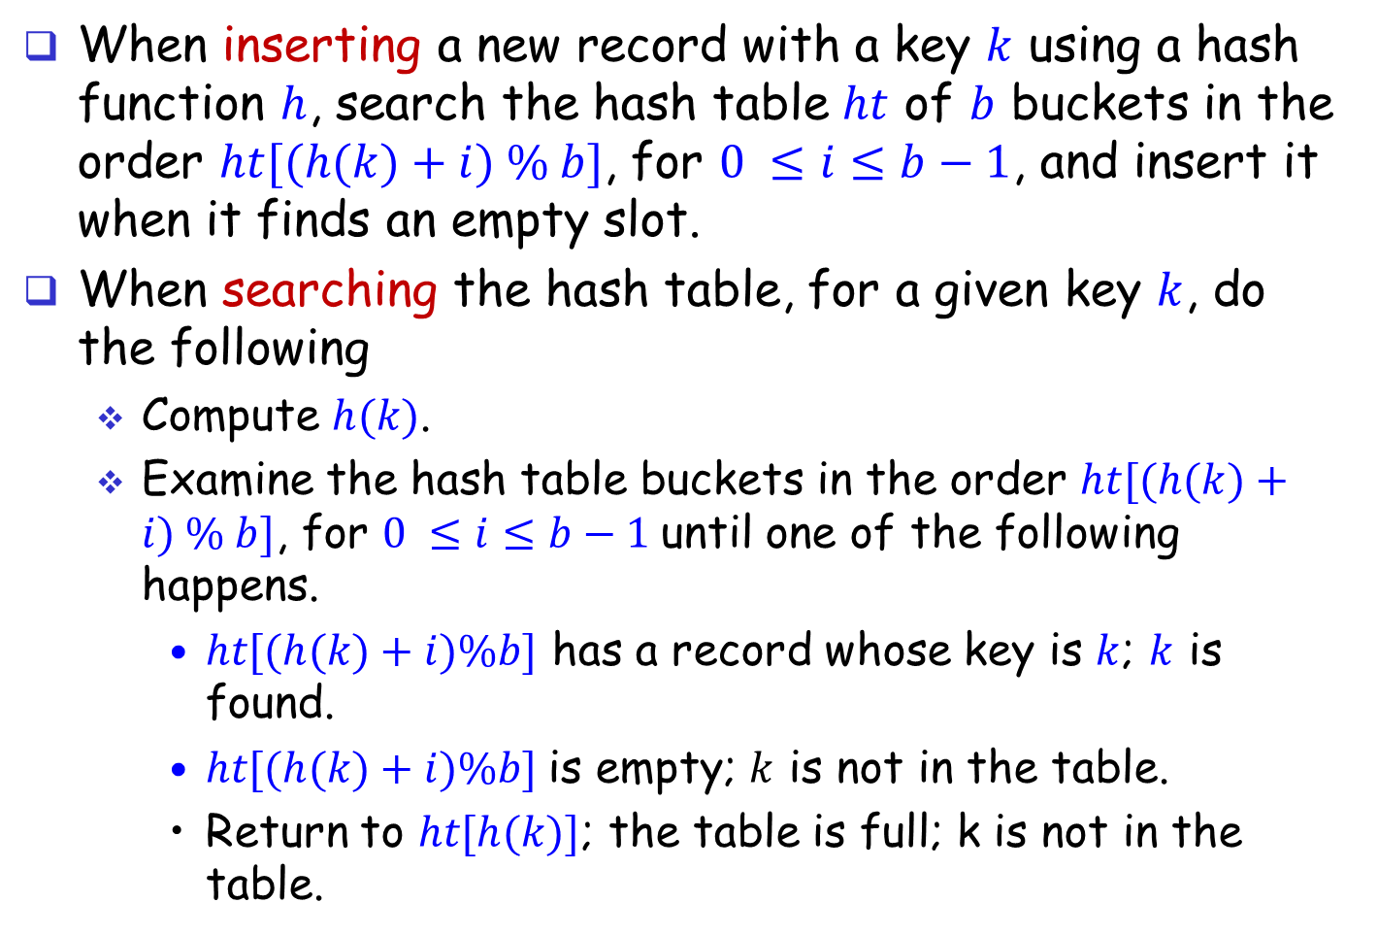
Linear Probing
When inserting a new record with a key $k$ using a hash function $h$, search the hash table $ht$ of $b$ buckets in the order $ht[(h(k)+i) \% b]$, for $0 ≤i≤b−1$, and insert it when it finds an empty slot.
When searching the hash table, for a given key $k$, do the following
Compute $h(k)$.
Examine the hash table buckets in the order $ht[(h(k)+i) \% b]$, for $0 ≤i≤b−1$until one of the following happens.
$ht[(h(k)+i)\%b]$ has a record whose key is $k$; $k$ is found.
$ht[(h(k)+i)\%b]$is empty; $k$ is not in the table.
Return to $ht[h(k)]$; the table is full; k is not in the table.

Slide 21
Linear Probing: Searching
Search hash table ht of b bucket with a hash function h using the linear probing where each bucket has 1 slot.
typedef struct { int key; …;} element;
element* search(int k) {
homeBucket = h(k);
for (currBucket = homeBucket; ht[currBucket] != NULL && ht[currBucket]->key != k; ) {
currBucket = (currBucket + 1) % b; /* circular list */
if (currBucket == homeBucket)
return NULL; /*back to start point */
}
if (ht[currBucket]->key == k) return ht[currBucket];
return NULL;
}

Slide 22
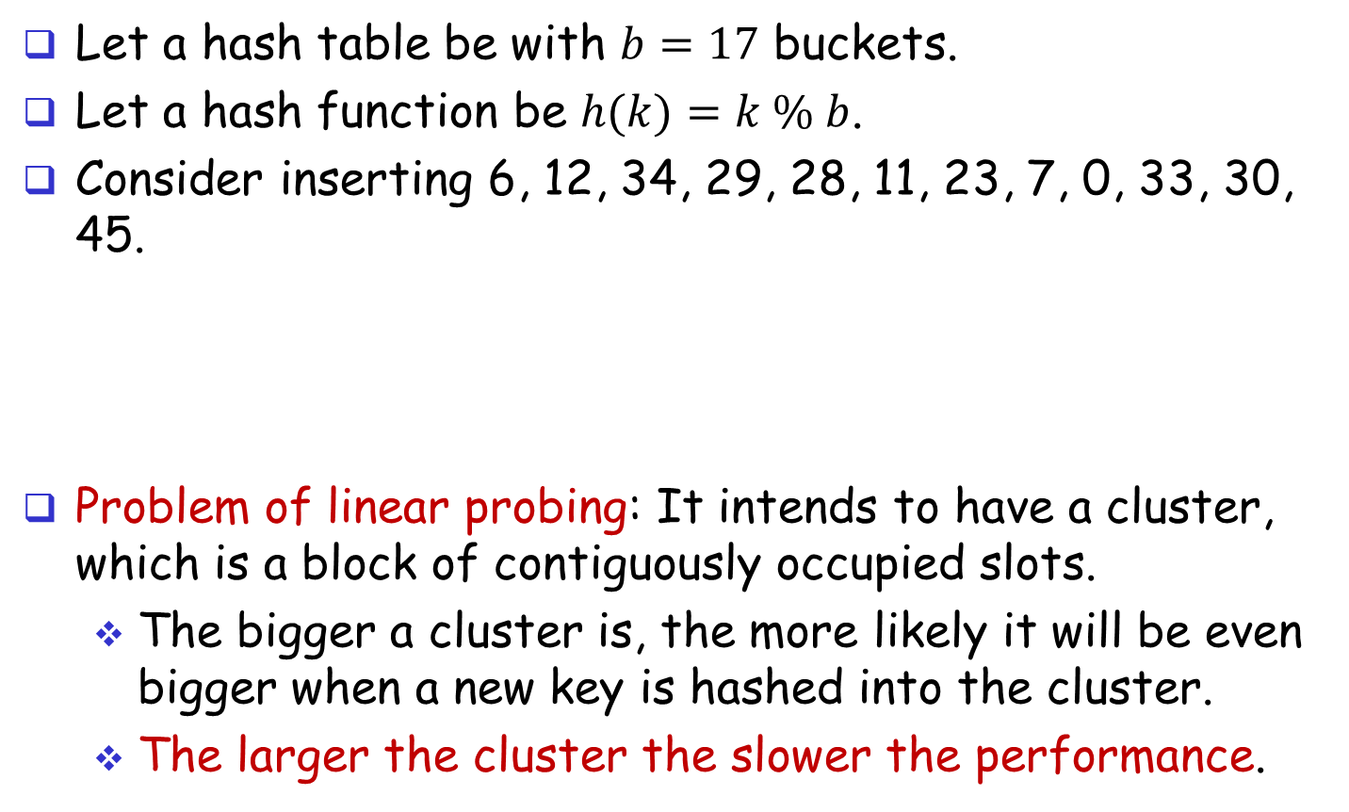
Linear Probing
Let a hash table be with $b=17$ buckets.
Let a hash function be $h(k)=k \% b$.
Consider inserting 6, 12, 34, 29, 28, 11, 23, 7, 0, 33, 30, 45.
Problem of linear probing: It intends to have a cluster, which is a block of contiguously occupied slots.
The bigger a cluster is, the more likely it will be even bigger when a new key is hashed into the cluster.
The larger the cluster the slower the performance.
0
4
8
12
16
34
0
45
6
23
7
28
12
29
11
30
33

Slide 23
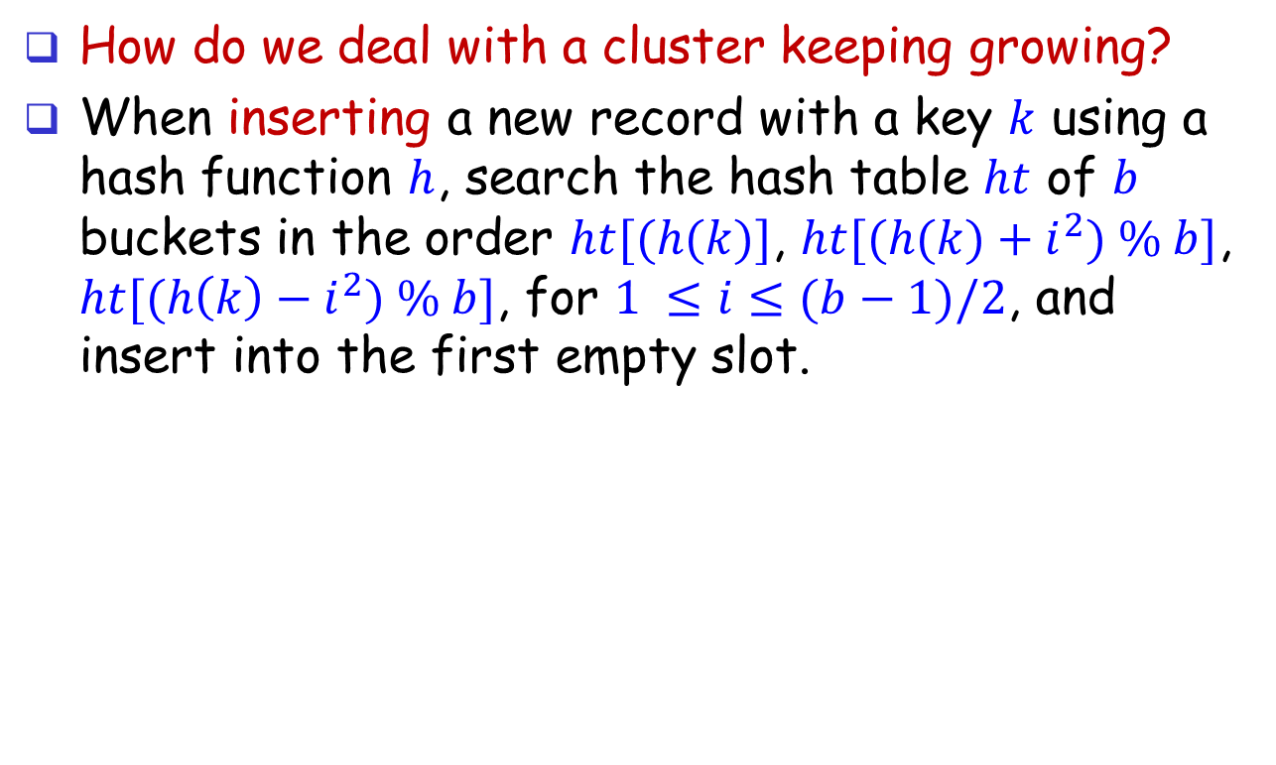
Quadratic Probing
How do we deal with a cluster keeping growing?
When inserting a new record with a key $k$ using a hash function $h$, search the hash table $ht$ of $b$ buckets in the order $ht[(h(k)]$, $ht[(h(k)+i^{2}) \% b]$, $ht[(h\left(k\right)−i^{2}) \% b]$, for $1 ≤i≤(b−1)/2$, and insert into the first empty slot.

Slide 24
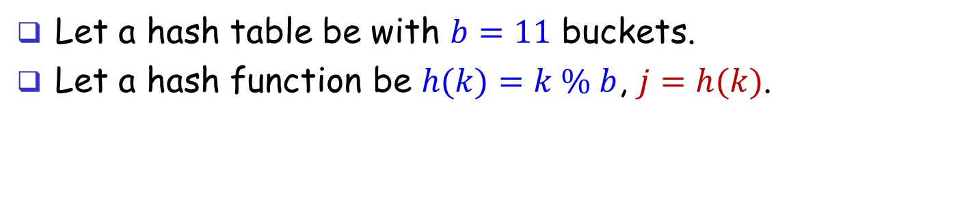
Quadratic Probing
Let a hash table be with $b=11$ buckets.
Let a hash function be $h(k)=k \% b$, $j=h(k)$.
j | j+1 | j-1 | j+4 | j-4 | j+9 | j-9 | j+16 | j-16 | j+25 | j-25
0 | 1 | - | 4 | - | 9 | - | 5 | - | 3 | -
1 | 2 | 0 | 5 | - | 10 | - | 6 | - | 4 | -
2 | 3 | 1 | 6 | - | 0 | - | 7 | - | 5 | -
3 | 4 | 2 | 7 | - | 1 | - | 8 | - | 6 | -
4 | 5 | 3 | 8 | 0 | 2 | - | 9 | - | 7 | -
5 | 6 | 4 | 9 | 1 | 3 | - | 10 | - | 8 | -
6 | 7 | 5 | 10 | 2 | 4 | - | 0 | - | 9 | -
7 | 8 | 6 | 0 | 3 | 5 | - | 1 | - | 10 | -
8 | 9 | 7 | 1 | 4 | 6 | - | 2 | - | 0 | -
9 | 10 | 8 | 2 | 5 | 7 | 0 | 3 | - | 1 | -
10 | 0 | 9 | 3 | 6 | 8 | 1 | 4 | - | 2 | -

Slide 25
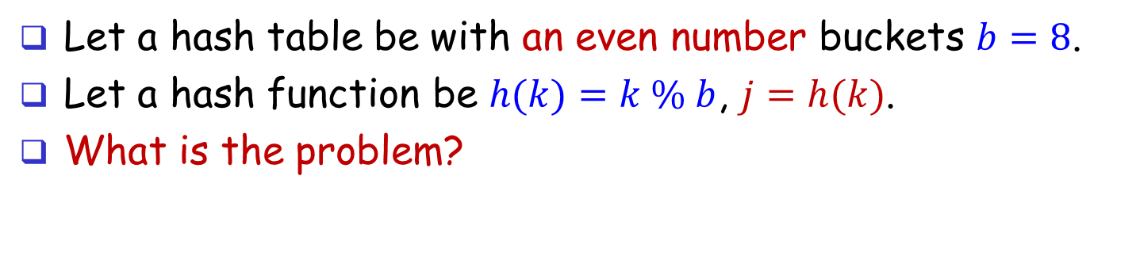
Quadratic Probing
Let a hash table be with an even number buckets $b=8$.
Let a hash function be $h(k)=k \% b$, $j=h(k)$.
What is the problem?
j | j+1 | j-1 | j+4 | j-4 | j+9 | j-9 | j+16 | j-16
0 | 1 | - | 4 | - | 1 | - | 0 | -
1 | 2 | 0 | 5 | - | 2 | - | 1 | -
2 | 3 | 1 | 6 | - | 3 | - | 2 | -
3 | 4 | 2 | 7 | - | 4 | - | 3 | -
4 | 5 | 3 | 0 | 0 | 5 | - | 4 | -
5 | 6 | 4 | 1 | 1 | 6 | - | 5 | -
6 | 7 | 5 | 2 | 2 | 7 | - | 6 | -
7 | 0 | 6 | 3 | 3 | 0 | - | 7 | -

Slide 26
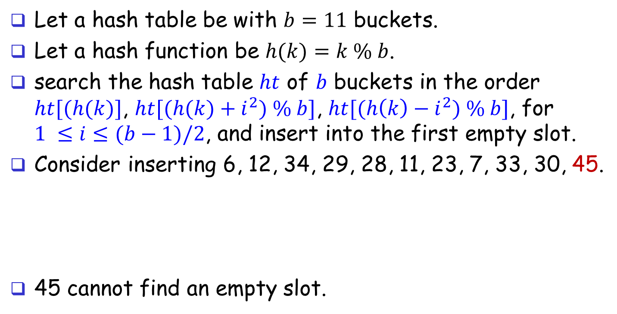
Can Quadratic Probing always find an empty slot?
Let a hash table be with $b=11$ buckets.
Let a hash function be $h(k)=k \% b$.
search the hash table $ht$ of $b$ buckets in the order $ht[(h(k)]$, $ht[(h(k)+i^{2}) \% b]$, $ht[(h\left(k\right)−i^{2}) \% b]$, for $1 ≤i≤(b−1)/2$, and insert into the first empty slot.
Consider inserting 6, 12, 34, 29, 28, 11, 23, 7, 33, 30, 45.
45 cannot find an empty slot.
0
4
8
10
11
12
34
33
28
6
29
7
30
23

Slide 27
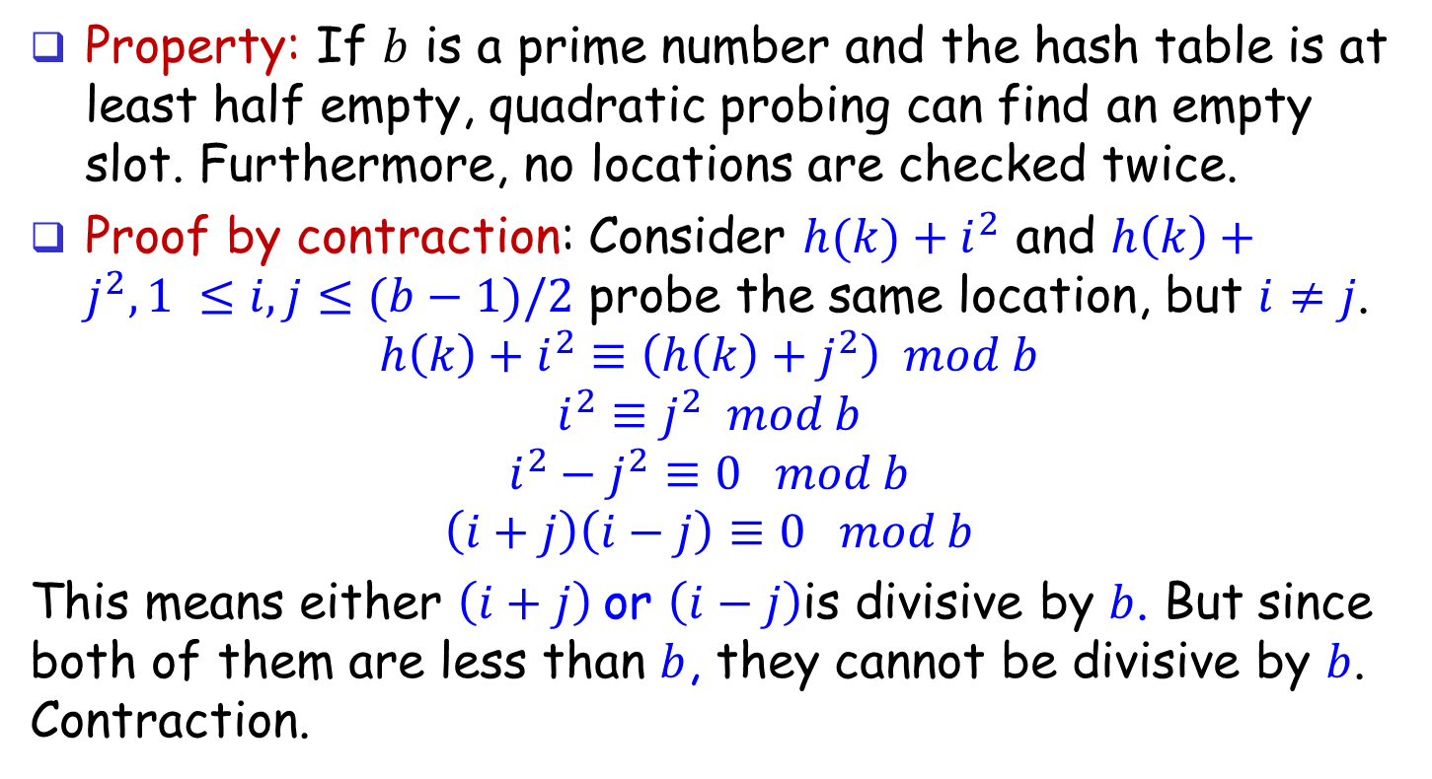
Guarantee of Quadratic Probing
Property: If $b$ is a prime number and the hash table is at least half empty, quadratic probing can find an empty slot. Furthermore, no locations are checked twice.
Proof by contraction: Consider $h(k)+i^{2}$ and $h\left(k\right)+j^{2},1 ≤i,j≤(b−1)/2$ probe the same location, but $i≠j$.
$$h\left(k\right)+i^{2}≡\left(h\left(k\right)+j^{2}\right) mod b$$
$$i^{2}≡j^{2} mod b$$
$$i^{2}−j^{2}≡0 mod b$$
$$\left(i+j\right)\left(i−j\right)≡0 mod b$$
This means either $\left(i+j\right)$or $\left(i−j\right)$is divisive by $b$. But since both of them are less than $b$, they cannot be divisive by $b$. Contraction.

Slide 28
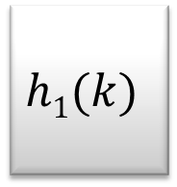
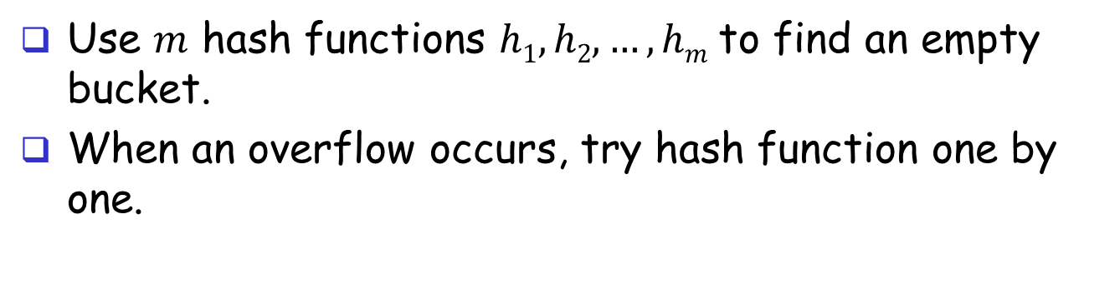

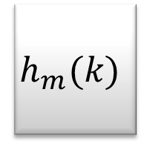
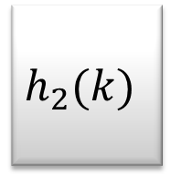
Hash Function: Rehashing
Use $m$ hash functions $h1, h2, …, hm$to find an empty bucket.
When an overflow occurs, try hash function one by one.
$$h1(k)$$
$$h_{2}(k)$$
$$h_{m}(k)$$
$$k$$

Slide 29
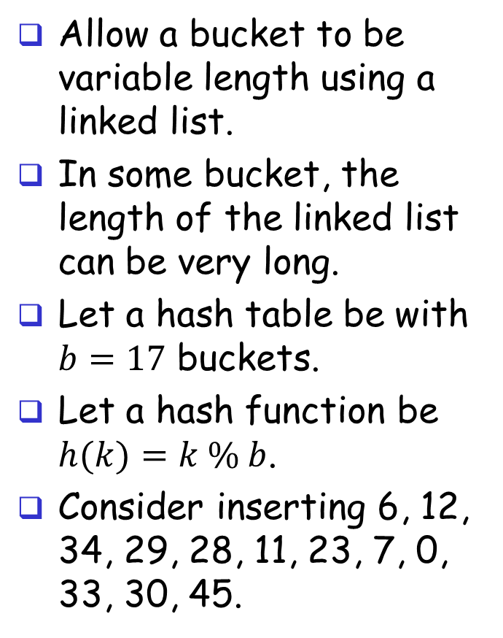
Chaining
[0]
34
0
Allow a bucket to be variable length using a linked list.
In some bucket, the length of the linked list can be very long.
Let a hash table be with $b=17$ buckets.
Let a hash function be $h(k)=k \% b$.
Consider inserting 6, 12, 34, 29, 28, 11, 23, 7, 0, 33, 30, 45.
[4]
6
23
7
[8]
11
28
45
[12]
12
29
30
[16]
33

Slide 30
Chaining: Searching
Search hash table ht of b bucket with a hash function h using chaining.
typedef struct { int key; …;} element;
typedef struct {element* data; list *link} list;
element* search(int k) {
int homeBucket = h(k);
list *current;
for (current = ht[homeBucket]; current != NULL; current = current->link)
if (current->data.key == k) return current->data;
return NULL;
}

Slide 31
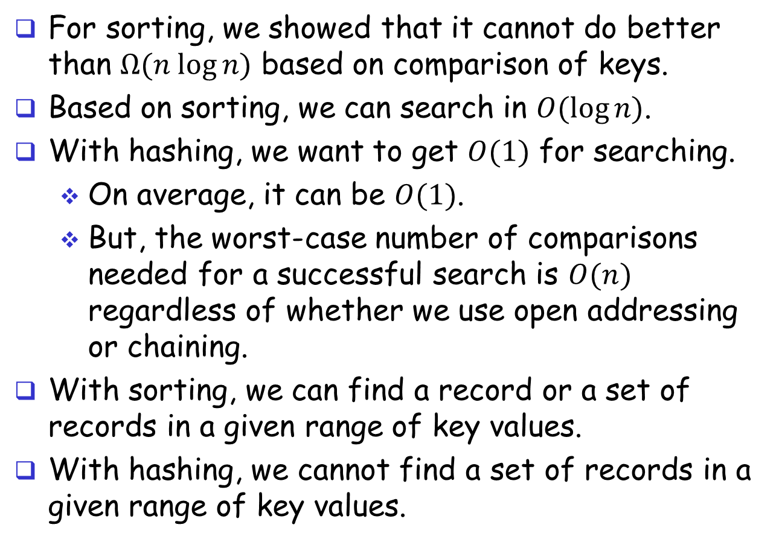
Sorting vs Hashing
For sorting, we showed that it cannot do better than $Ω(n log⁡n)$ based on comparison of keys.
Based on sorting, we can search in $O(log⁡n)$.
With hashing, we want to get $O(1)$ for searching.
On average, it can be $O(1)$.
But, the worst-case number of comparisons needed for a successful search is $O(n)$ regardless of whether we use open addressing or chaining.
With sorting, we can find a record or a set of records in a given range of key values.
With hashing, we cannot find a set of records in a given range of key values.

